Slide 1
Imaging of mTBI/Concussion
Calvin H Flowers MD
Neuroradiologist
Swedish Covenant Hospital Chicago
Former Staff Physician/Co-Director MRI Center
Jesse Brown VA Medical Center Chicago

Slide 2
Traumatic Brain Injury (TBI)- Description
“ Disruption of brain function as a result of an external force marked by LOC, PTA, Alteration in Mental Status, Neurologic deficits or intracranial lesions”

Slide 3
Traumatic Brain Injury
Incidence rate- over 500 cases/100,000 per yr
TBI related disability 33/100,000 new cases/yr
More than 50,000 deaths per year
TBI’s costs > 50-Billion per year
Survivors of TBI left w cognitive,behavioural and communicative disabilities (NIH-TBI 2002)

Slide 4
Traumatic Brain Injury
Traumatic brain injury (TBI) has been all over the news — and consequently on the minds of Americans. Yet, TBI is neither a new problem nor a rare malady. TBI ranges from mild TBI (concussion), moderate TBI (usually associated with a loss of consciousness at the time of injury), and severe TBI.
The Centers for Disease Control and Prevention estimated that 1.5 million Americans sustained TBI annually in 2000. As of 2006, the estimates had risen to 1.7 million brain injuries per year. These prevalence proportions will increase as military personnel return home and the problem of repeated mild TBI (mTBI) becomes more recognized in sports. Current estimates of TBI among veterans range from 9.6% to 20%, with an estimated total of more than 300,000 cases among military personnel since 2000. The current estimates of combined sports-related concussions and brain injuries in the United States are 1.6-3.8 million each year.

Slide 5
Traumatic Brain Injury
The joint Veterans Health Administration/Department of Defense clinical practice guidelines classified TBI severity on the basis of the American College of Rehabilitation Medicine (ACRM) definitions.
Severe TBI requires loss of consciousness >24 hours; alteration of consciousness >24 hours; posttraumatic amnesia >7 days; Glasgow Coma Scale <9; and normal or abnormal structural imaging.
Moderate TBI requires loss of consciousness >30 minutes but <24 hours; alteration of consciousness >24 hours; posttraumatic amnesia >1 day but <7 days; Glasgow Coma Scale 9-12; and normal or abnormal structural imaging.
Mild TBI (concussion) involves loss of consciousness 0-30 minutes; alteration of consciousness momentary or <24 hours; posttraumatic amnesia 0-1 day; Glasgow Coma Scale 13-15; and normal structural imaging

Slide 6
Traumatic Brain Injury
Research studies in civilian populations indicate that residual deficits are likely following both moderate and severe TBI, whereas most people recover fully following a mild TBI (McCrea et al., 2009). However, multiple studies indicate that a minority evidence long-term problems following even a mild TBI, although the causal link to the TBI is considered controversial by some groups.
A set of studies used data from the Vietnam Experience Study to assess long-term outcomes following mild TBI compared to injury without TBI and no injury (Vanderploeg et al., 2005; Vanderploeg et al., 2007). Although the groups were similar on many measures, mild TBI was associated with sequelae including increased risk for depression, psychosocial problems, and subtle neurologic and neuropsychological deficits.

Slide 7
Traumatic Brain Injury
Recent studies are of potential relevance especially to the OEF/OIF cohort, as they address issues related to experiencing more than a single concussion. One compared rates of recovery in athletes between their first and second concussion (separated by no more than one year) (Slobounov et al., 2007). Commonly measured symptoms (neurological, neuropsychological, clinical) resolved much more quickly (<10 days) than balance deficits measured in a virtual reality environment (>30 days), and recovery from the second concussion was significantly slower than from the first.

Slide 8
Traumatic Brain Injury
Research studies in civilians generally require confirmation of the injury by persons other than the patient (e.g., witness, emergency responder, emergency room personnel). As a result, most studies are based on populations that sought medical care (e.g., emergency room, specialty clinic) and thus represent only a portion of the population that has experienced a TBI. The injury context is also quite different, with few of the physical and psychological stressors that are common in the combat theatre. In addition, most studies involve recovery from a single injury event. The few studies of multiple injury events are almost entirely of sports-related concussions.

Slide 9
Traumatic Brain Injury
Most injured personnel were able to return to duty (RTD) rather than requiring out-of-theatre evacuation (14%-27% evacuated). One study reported an average of 3 days (range 0-30) for RTD (Gondusky & Reiter, 2005). Data from the Joint Theatre Trauma Registry for OEF/OIF combat-related injuries between October 2001 and January 2005 indicated that approximately 18% were RTD within 3 days (Owens et al., 2008).
A study comparing OEF/OIF Veterans receiving care at a VA Polytrauma Rehabilitation Center with combat-related TBI (74% explosion-related) to those with non-combat TBI (71% motor vehicle accidents) found higher report of vision impairments (>50% versus <30%), sensitivity to light or noise (~40% versus <10%), sleep disturbances (>50% versus <30%), and symptoms of acute stress reaction or PTSD (>30% versus <5%) (lew et al., 2006)

Slide 10
Approximately 20% of OEF/OIF veterans completing the VA’s brief TBI screen give positive answers to all four questions, indicating a probable historic TBI while deployed and possible persistent postconcussive symptoms (PPCS) (lew, Otis et al., 2009).
Veterans who screen positive are referred for a full evaluation by experienced clinicians as part of the VA’s polytrauma program. Several VA sites have reported initial results from this follow-up evaluation. One found that 67% were confirmed to have PPCS, and more than 40% had PPCS, PTSD, and chronic pain (polytrauma clinical triad).

Slide 11
mTBI/Concussion
Concussion myths
Need to be knocked out (fewer than 10%)
Helmets and mouth guards prevent concussion
Normal CT/MRI scan rule out concussion
If someone has concussion you should keep them awake
Hitting your head is the only way to get concussion
Checking the pupils see if they are reactive

Slide 12
mTBI/Concussion
Concussion Facts
85% of all head trauma classified as mTBI/Concussion
45% of Athletes do not report feeling any symptoms
After 1st concussion there is a 3-fold increase risk of 2nd
Soccer is most common sport for female concussion

Slide 13
mTBI/Concussion
Pathophysiology
Deceleration/rotational injury
Blood vessel disruption
Petechial Bleeds
Focal edema
Disruption of bridging veins
Intra-Axonal neurofilament organization
Axonal Swelling
Secondary Injury
Excitatory amino acids
Oxygen Free Radicals

Slide 14
mTBI/Concussion
Pathophysiology
Complex Cascade of Biochemical, Metabolic and Gene expression changes.
(Severe Injury in animal Models)
What happens in Humans with mTBI/Concussion??

Slide 15
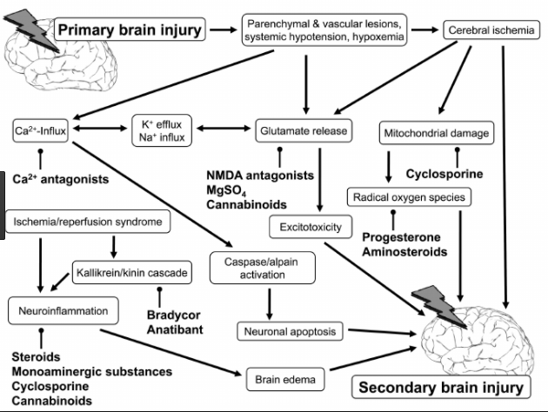
mTBI/Concussion

Slide 16
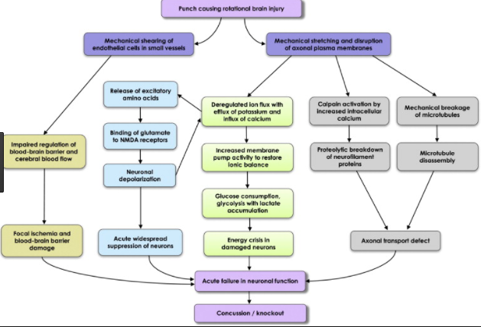
mTBI/Concussion

Slide 17
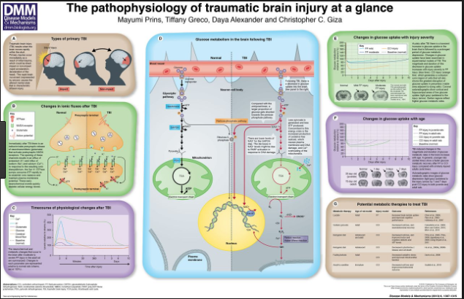
mTBI/Concussion

Slide 18
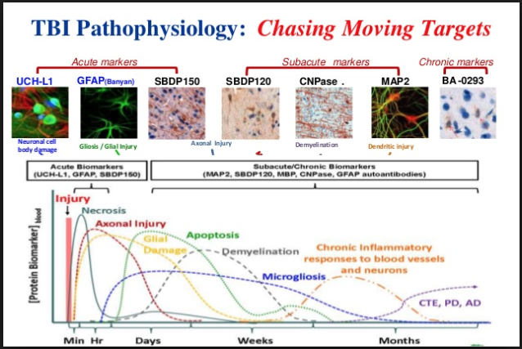
mTBI/Concussion

Slide 19
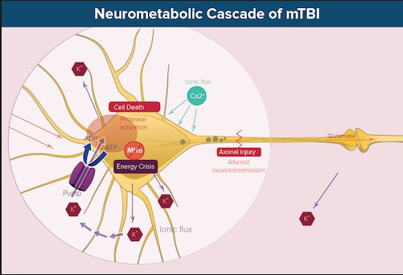
mTBI/Concussion

Slide 20
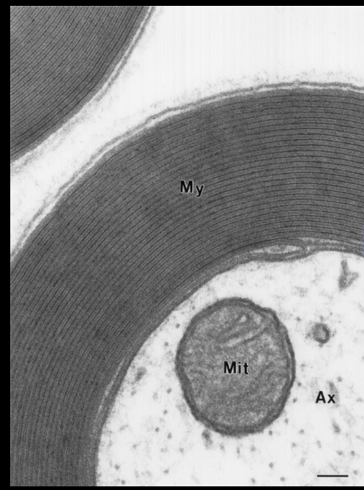
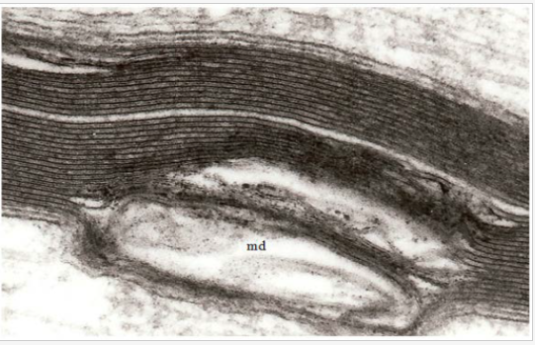
mTBI/Concussion

Slide 21
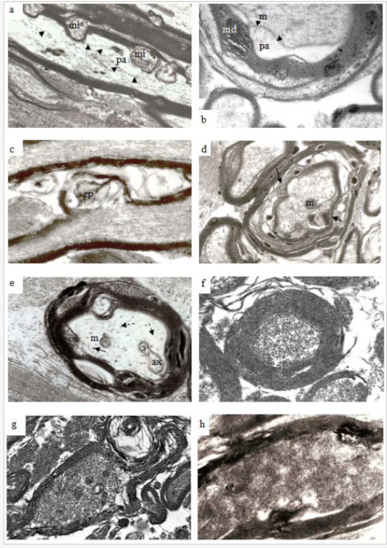
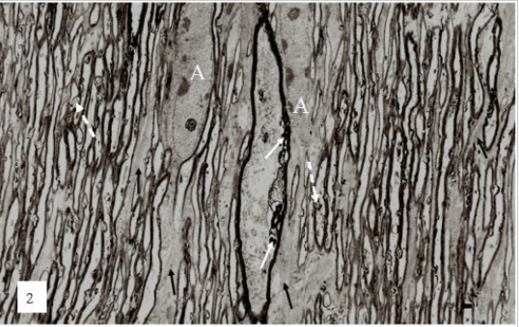
mTBI/Concussion

Slide 22
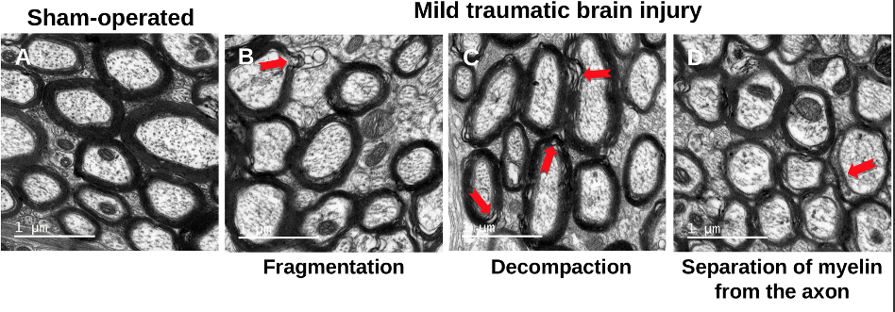
mTBI/Concussion

Slide 23
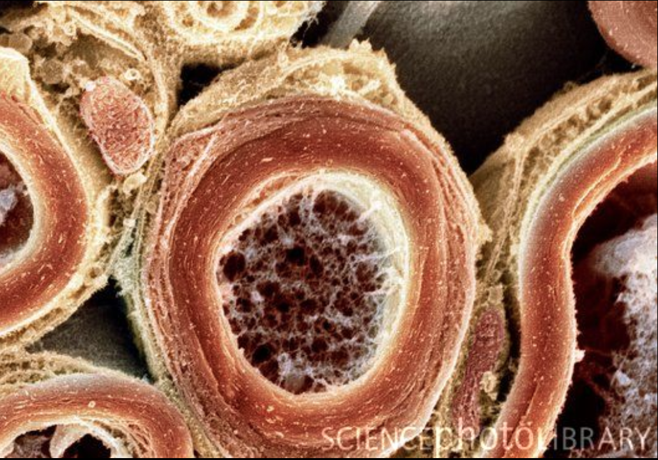
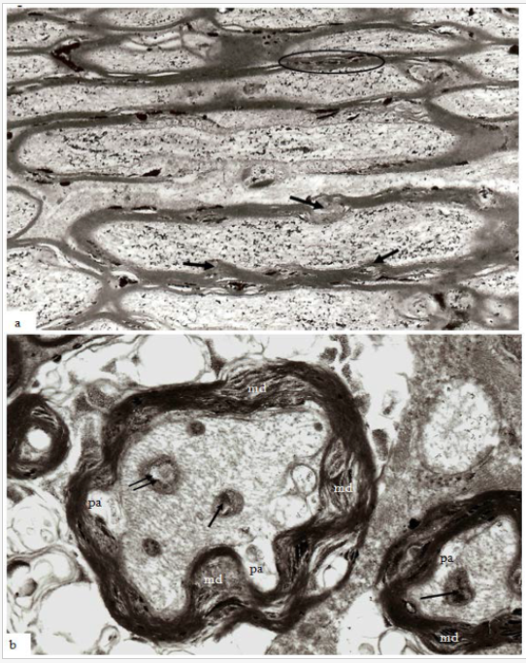
mTBI/Concussion

Slide 24
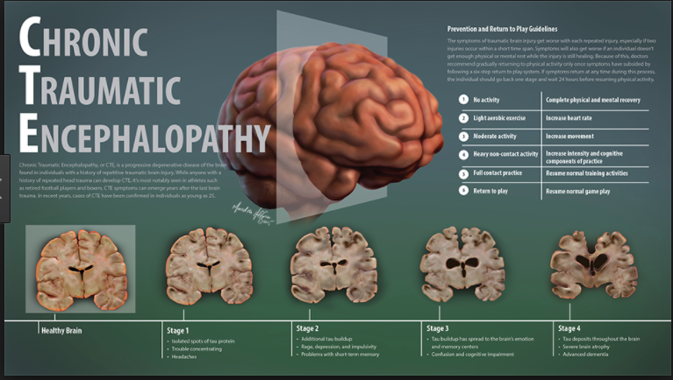

Slide 25
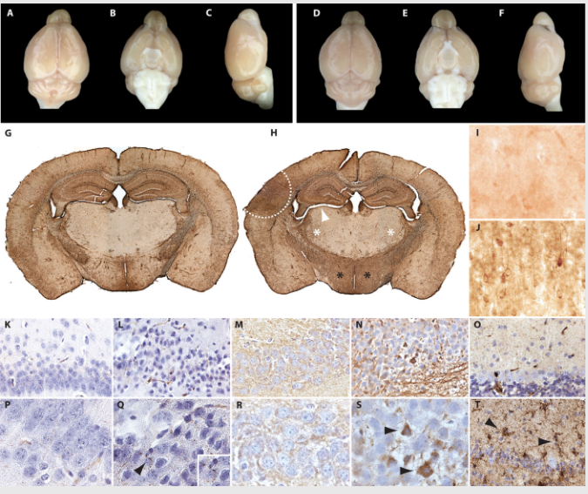
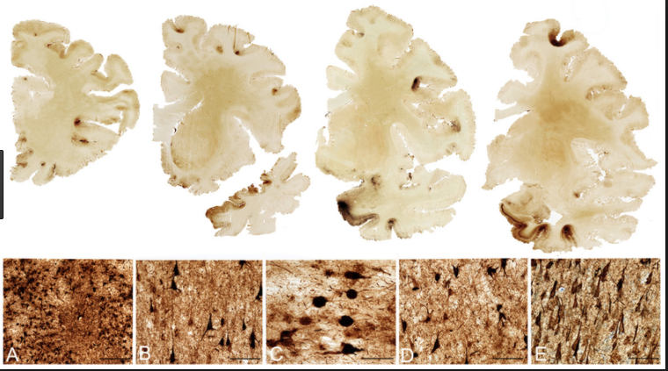
CHRONIC TRAUMATIC ENCEPHALOPATHY

Slide 26
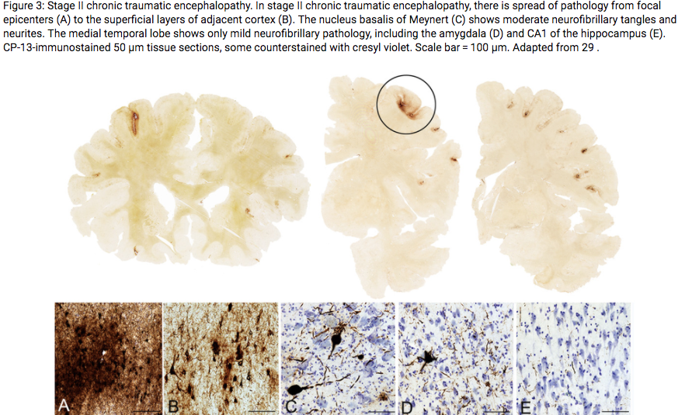
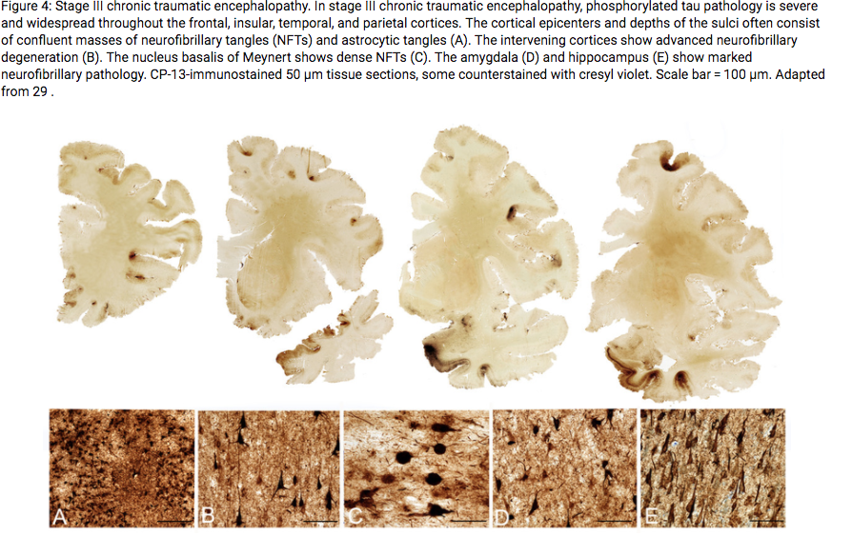
CHRONIC TRAUMATIC ENCEPHALOPATHY

Slide 27
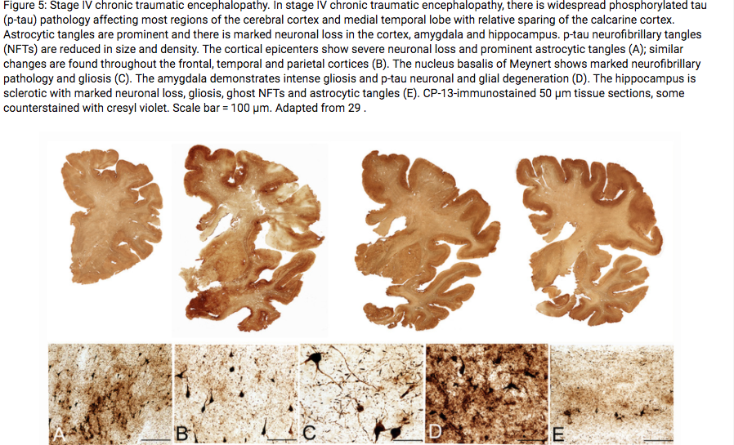
CHRONIC TRAUMATIC ENCEPHALOPATHY

Slide 28
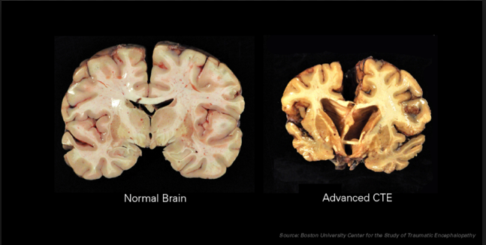
CHRONIC TRAUMATIC ENCEPHALOPATHY

Slide 29
Neuroimaging of mTBI/Concussion
Computed Tomography (CT)
Indications for CT Scanning
Considerably uncertainty about indications in Pts w mTBI
Although the incidence of intracranial lesions, especially those needing surgery, is low in mTBI/Concussion, the consequences of delayed diagnosis are forbidding.
Adverse outcome of an intracranial hematoma is costly and it balances the expense of CT Scans and CT Scanning in mTBI appears justified

Slide 30
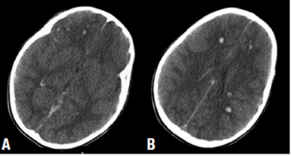
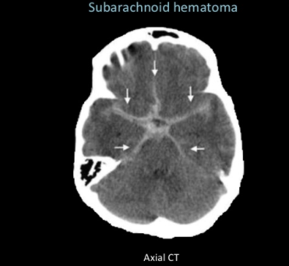
Neuroimaging of mTBI/Concussion
Computed Tomography (CT)
CT imaging missed 10-20% of injuries in mTBI/concussion
Altogether MRI is 30% more sensitive than CT imaging in Pts with mTBI/Concussion

Slide 31
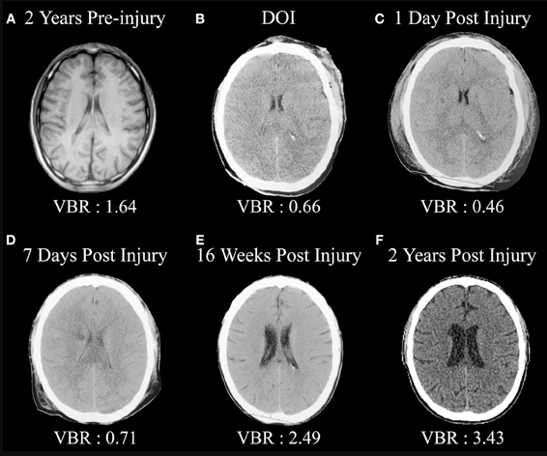
Neuroimaging of mTBI/Concussion
CT Imaging

Slide 32
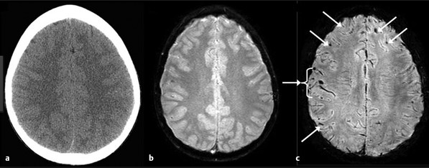
Neuroimaging of mTBI/Concussion
MRI Imaging
Patient with mTBI/Concussion Susceptibility Weighted Imaging
(SWI) Showing Microbleeds on the SWI Axial image
Normal CT GRE SWI

Slide 33
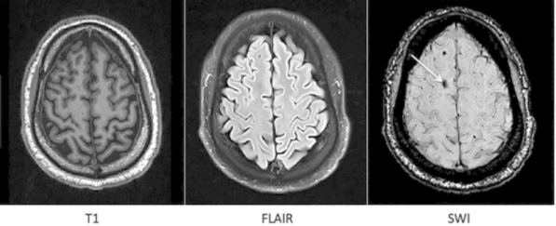
Neuroimaging of mTBI/Concussion
MRI Imaging
Patient with mTBI/Concussion Demonstrating petechial Bld.
T1-W FLAIR SWI

Slide 34
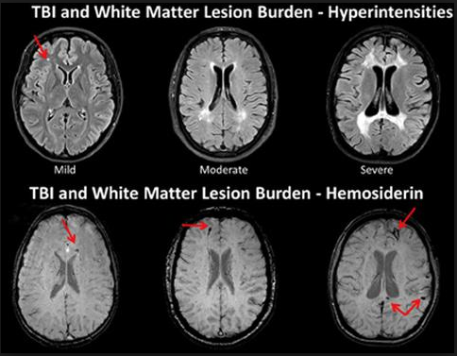
Neuroimaging of mTBI/Concussion
MRI Imaging sensitive for DAI-Diffuse Axonal Injury

Slide 35
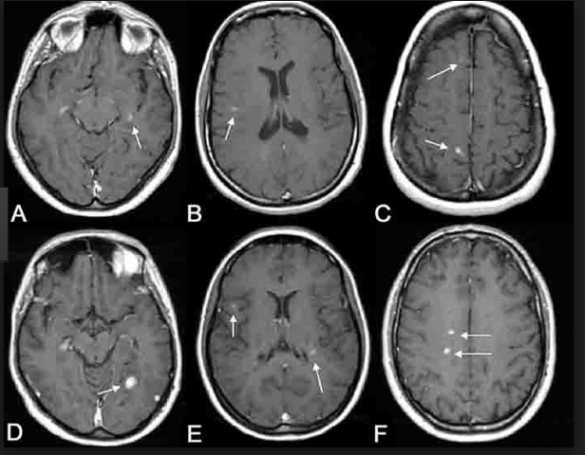
Neuroimaging of mTBI/Concussion
MRI Imaging sensitive for DAI-Diffuse Axonal Injury
Ti-Weighted Sequences of mTBI/Concussion

Slide 36
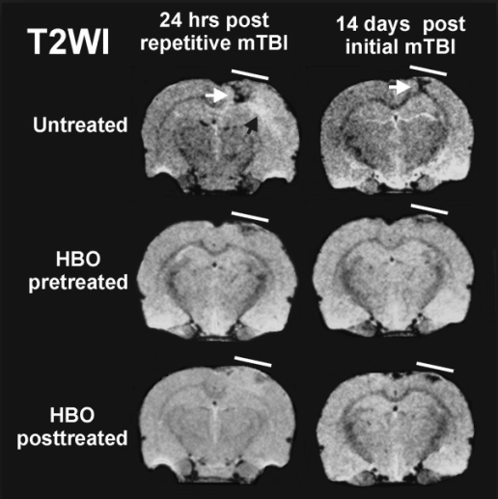
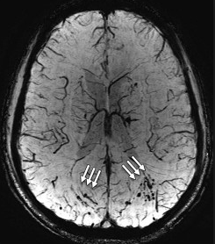
Neuroimaging of mTBI/Concussion
MRI Imaging sensitive for DAI-Diffuse Axonal Injury
SWI Sequences sensitive for DAI and Microbleeds

Slide 37
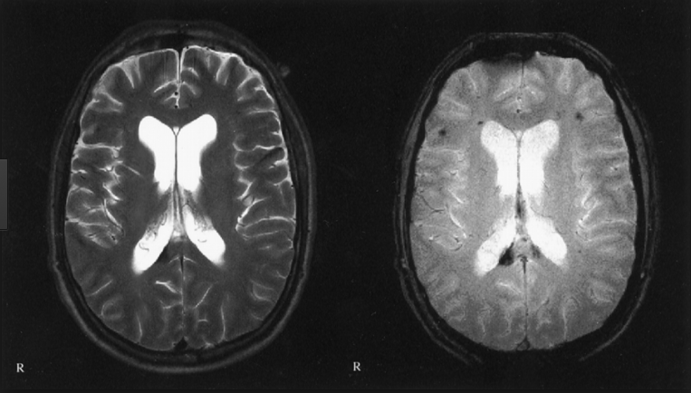
Neuroimaging of mTBI/Concussion
MRI Imaging sensitive for DAI-Diffuse Axonal Injury
T2-w and SWI Axial Images Showing DAI Splenium of CC

Slide 38
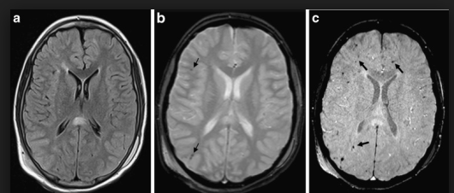
Neuroimaging of mTBI/Concussion
MRI Imaging sensitive for DAI-Diffuse Axonal Injury
T2-w and SWI Axial Images Showing DAI Splenium of CC
FLAIR GRE SWI

Slide 39
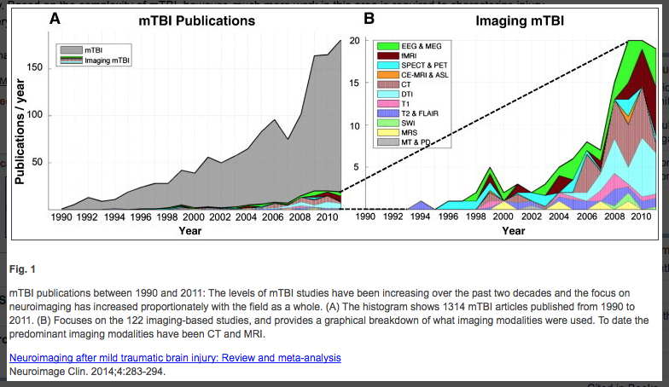
Neuroimaging of mTBI/Concussion
Advanced MRI Techniques

Slide 40
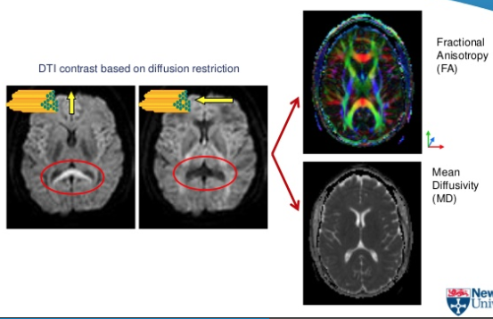
Neuroimaging of mTBI/Concussion
Diffusion Weighted MR Imaging
Diffusion Tensor Imaging

Slide 41
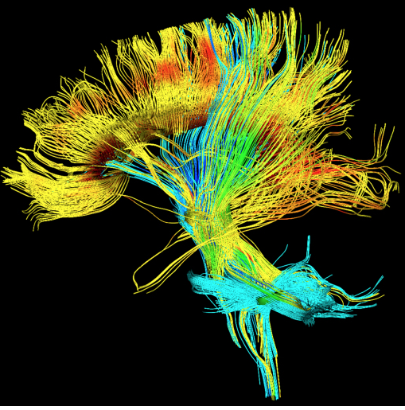
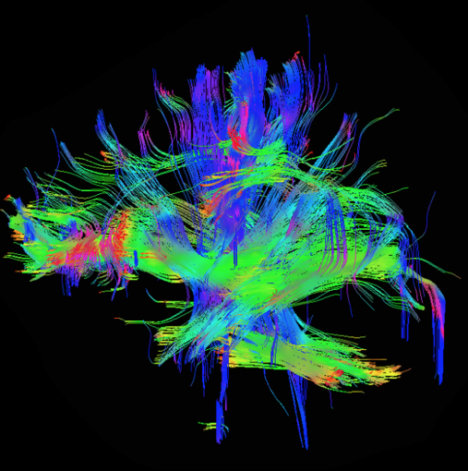
Neuroimaging of mTBI/Concussion
Diffusion Weighted MR Imaging
Diffusion Tensor Imaging

Slide 42
Neuroimaging of mTBI/Concussion
Diffusion Tensor Imaging
DTI show white matter tract integrity
Water diffusion normal is random and same in all directions
In white matter fiber tracts, water diffusion is hindered perpendicular to tract and higher in direction parallel to fiber
More sensitive in detecting signs of TBI than routine MRI
Reduction in Corpus Callosum,Internal capsule, Centrum Semiovale and Cingulum
Superior at detecting DAI injury
FA= Fractional anisotropy vs MD= Median diffusivity

Slide 43
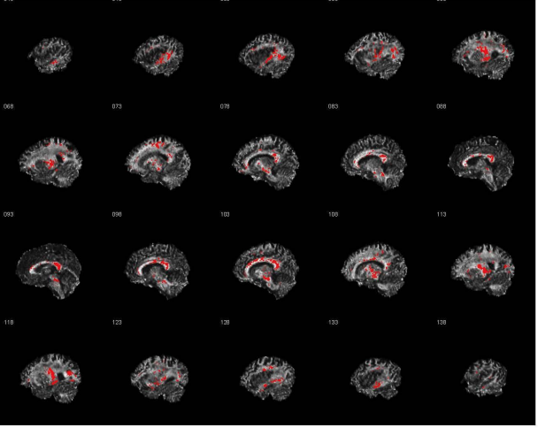
Neuroimaging of mTBI/Concussion
Diffusion Tensor Imaging FA Map

Slide 44
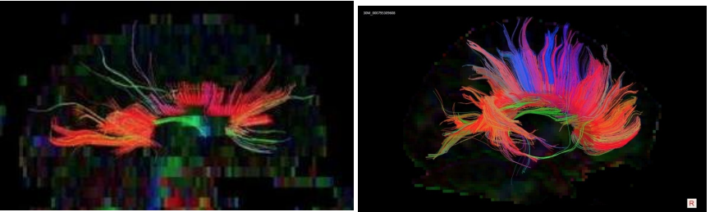
Neuroimaging of mTBI/Concussion
Diffusion Tensor Imaging FA Map
mTBI/Concussion Normal Control Patient

Slide 45
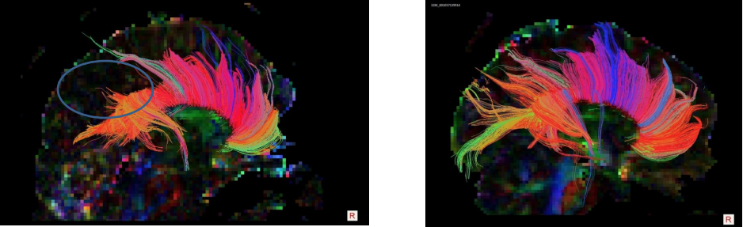
Neuroimaging of mTBI/Concussion
Diffusion Tensor Imaging FA Map
mTBI/Concussion Normal Control Patient

Slide 46
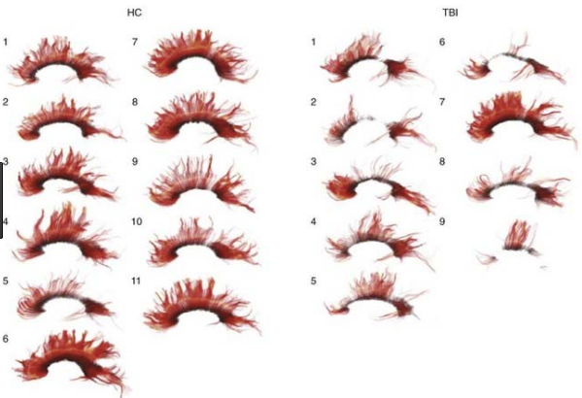
Neuroimaging of mTBI/Concussion
Diffusion Tensor Imaging

Slide 47
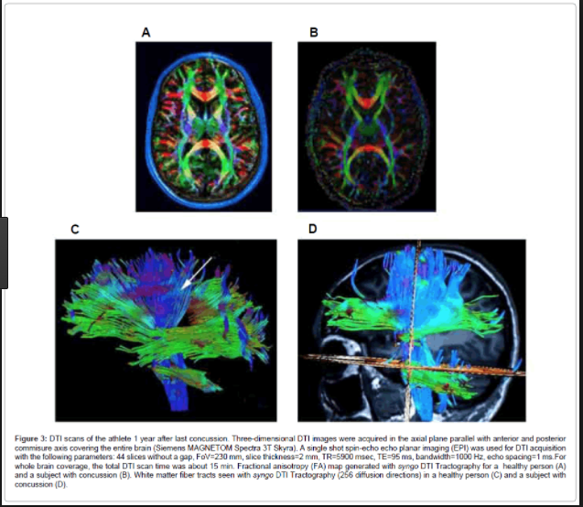
Neuroimaging of mTBI/Concussion
Diffusion Weighted MR Imaging
Diffusion Tensor Imaging

Slide 48
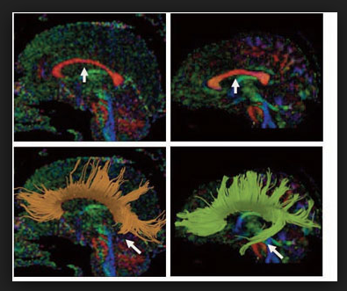
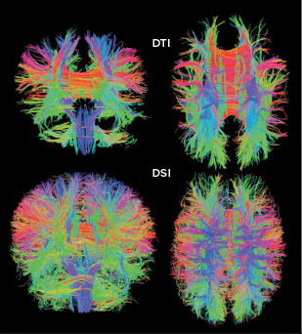
Neuroimaging of mTBI/Concussion
Diffusion Tensor Imaging
mTBI Control DTI vs DSI

Slide 49
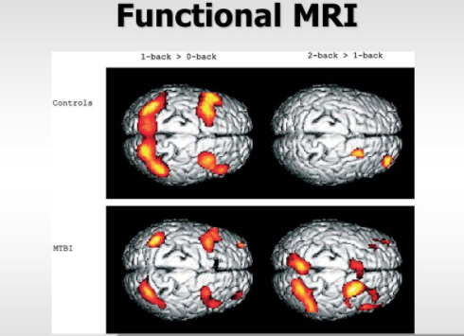

Slide 50
Increase in cerebrovascular reactivity (CVR) seen in athletes following sports-related mTBI/Concussion which may be related to the recurring headache symptoms which may be indicator of acute injury (Militan A.R. et al 2014)
The CVR is increased by 33% across all regions of interest in concussed athletes compared to controls.
CVR increase was associated with more recent injury

Slide 51
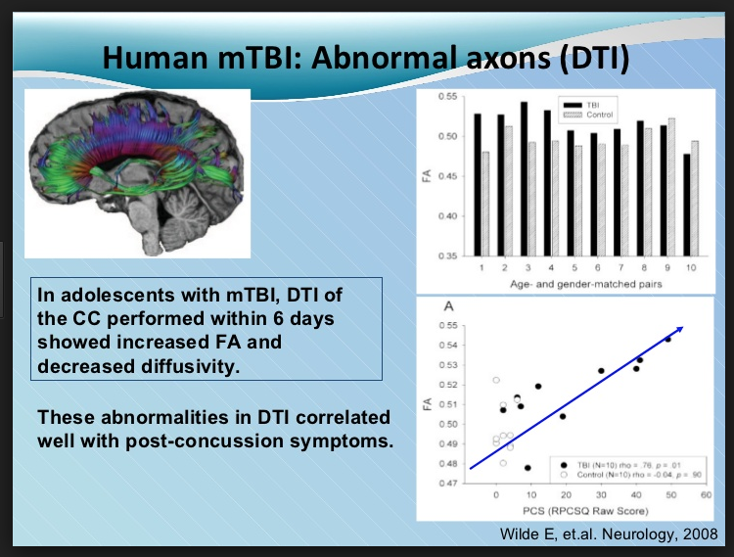
Neuroimaging of mTBI/Concussion
DTI

Slide 52
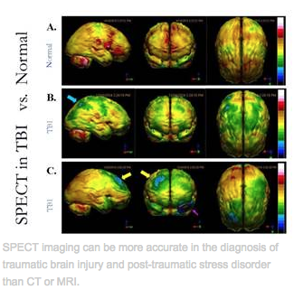
Neuroimaging of mTBI/Concussion
SPECT Imaging

Slide 53
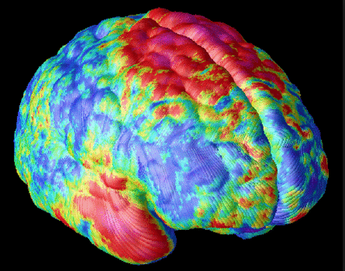
Neuroimaging of mTBI/Concussion
PET Imaging

Slide 54
Neuroimaging of mTBI/Concussion
PET Imaging
PET Positron Emission Tomography shows regional brain function e.g frontal lobe activity
FDG-deoxyglucose (Flourine-18 attached to sugar like compound
More sensitive than CT and MRI for mTBI/concussion
Abnormal decreased orbitofrontal , anterotemporal and hippocampal metabolism( portrayed as blue color map)
Corroboration between positive neuropsychological findings and PET
No differences with reported loss of conciousness vs none
Also show occipital increase activity ? Compensatory

Slide 55
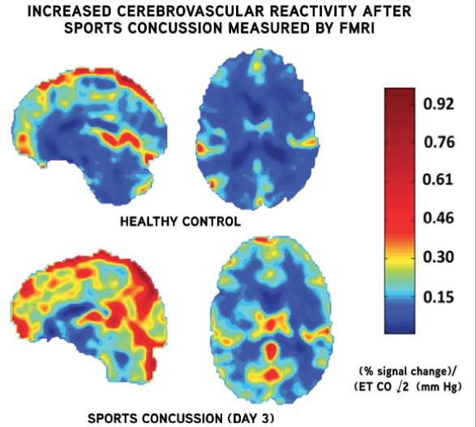
Neuroimaging of mTBI/Concussion
fMRI Imaging

Slide 56
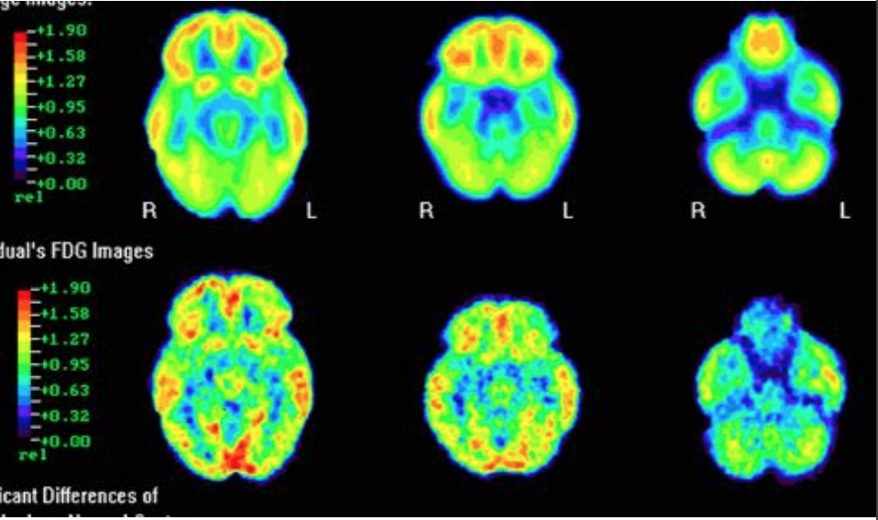
Neuroimaging of mTBI/Concussion
PET Imaging

Slide 57
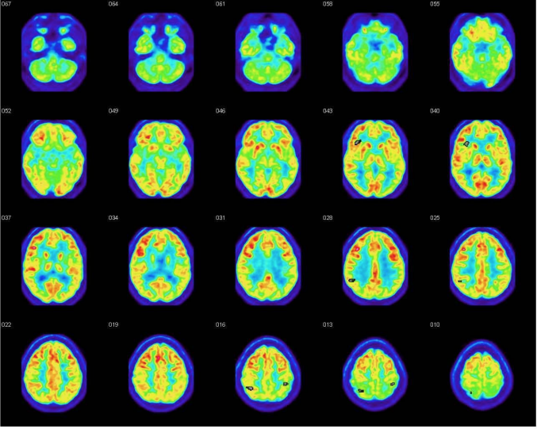
Neuroimaging of mTBI/Concussion
PET Imaging

Slide 58
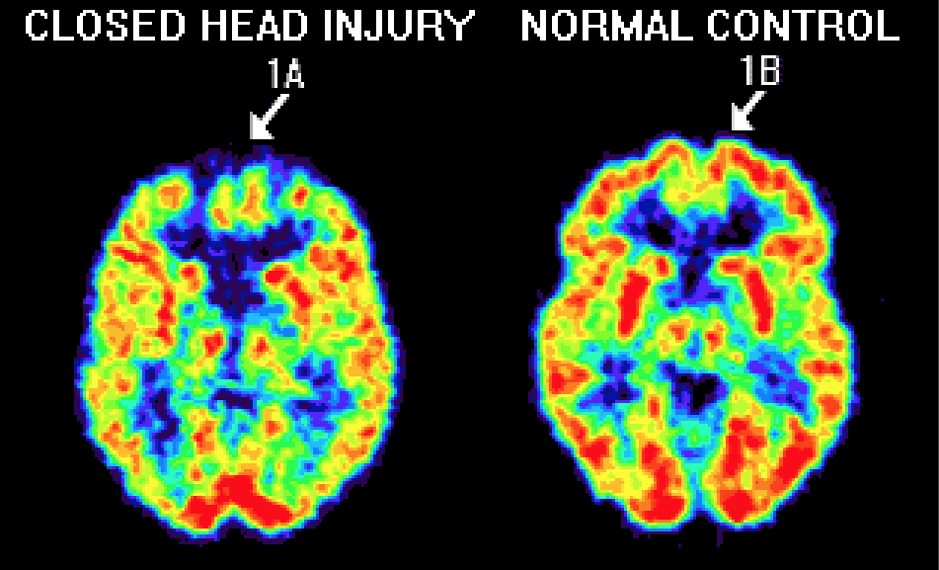
Neuroimaging of mTBI/Concussion
PET Imaging

Slide 59
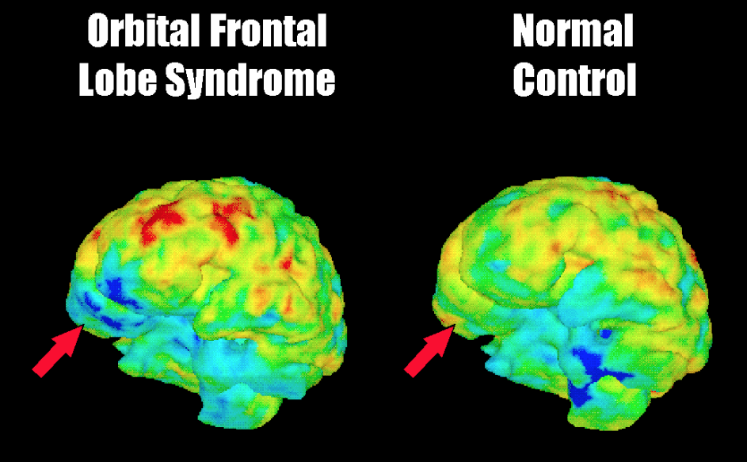
Neuroimaging of mTBI/Concussion
PET Imaging

Slide 60

Neuroimaging of mTBI/Concussion
MR Spectroscopy Imaging

Slide 61

Neuroimaging of mTBI/Concussion
MR Spectroscopy Imaging

Slide 62

Neuroimaging of mTBI/Concussion
MR Spectroscopy Imaging

Slide 63


Neuroimaging of mTBI/Concussion
MR Spectroscopy Imaging

Slide 64
Neuroimaging of mTBI/Concussion
MR Spectroscopy Imaging

Slide 65

Neuroimaging of mTBI/Concussion
MR Spectroscopy Imaging

Slide 66
Neuroimaging of mTBI/Concussion
MR Spectroscopy Imaging
1 H MRS provide an in vivo measure of neuronal health.
Proton MR Spectroscopy detects changes in cerebral metabolite levels in apparently normal regions. Pyramidal tracts( Internal capsules and cerebral peduncles
Significant decrease of NAA/Cho, Lip/Cr, Lac/Cr and Glx/Cr
Increase in Cho and myo-inositol in both white and gray matter.Frontal , parietal, occipital lobes as well as splenium of corpus callosum
Lactate levels seen in the acute phase

Slide 67
Neuroimaging of mTBI/Concussion
MR Spectroscopy Imaging
H MRS provide in vivo measure of neuronal health
N-acetylaspartate-(NAA) marker for neuronal density and Mitochondrial function
Choline-containing compounds (Cho) measure of the membrane synthesis/turnover
Creatine and Phosphocreatine (Cr + PCr) a measure of cellular metabolism
Myo-inositol (myo-I) is a major osmolite and precursor to several metabolite

Slide 68
Neuroimaging of mTBI/Concussion
MR Spectroscopy Imaging
Significant Decrease of NAA in mTBI/concussion
Altered metabolite concentrations in regions that appeared normal on MR imaging
Decrease in NAA in both gray and white matter
Increase Cho and Myo-inositol in both gray and white matter
Increase lactate seen in acute mTBI/Concussion
Decrease Glx in the gray matter
Increase levels of Creatine-phosphocreatine(Cr)
Cr levels were predictive of executive functions and emotional distress in both control and mTBI/concussion Pts

Slide 69
Neuroimaging of mTBI/Concussion
MR Spectroscopy Imaging
Perturbations of both Glutamate (Glu) the brain major neurotransmitter and Cr, a critical component of the brain’s energy metabolism seen following mTBI/concussion
NAA Mapping post-injury can be used to monitor metabolic recovery
Multislice MRSI is better suited for mTBI/Concussion over 3D-PRESS which is commonly used in facilities.
Concussion initiates a period of neuron vulnerability, marked by metabolic recovery which occurs after functional recovery. Zhu et al 2011

Slide 70

Neuroimaging of mTBI/Concussion
MR Spectroscopy Imaging

Slide 71


Neuroimaging of mTBI/Concussion
MEG Imaging

Slide 72

Neuroimaging of mTBI/Concussion
MEG Imaging

Slide 73

Neuroimaging of mTBI/Concussion
MEG Imaging

Slide 74

Neuroimaging of mTBI/Concussion
Myelin Imaging

Slide 75

Neuroimaging of mTBI/Concussion
PET

Slide 76

Neuroimaging of mTBI/Concussion
PET

Slide 77
Neuroimaging of mTBI/Concussion
Myelin Water Fraction
Reduction of myelin water fraction seen in brain areas during the season relative to preseason scans in the splenium,posterior thalamus on the left.
Myelin water fraction recovered to the pre-season values 2-months post injury.
Transient myelin disruption was not apparent in athletes who did not suffer concussion, despite exposure to repetitive subconcussive trauma over season of collegiate hockey ( Wright et al 2016)

Slide 78
Neuroimaging of mTBI/Concussion
Biomechanical loading
Impact Bio-Mechanical loading with transference of energy by direct impact
Inertial Bio-mechanical loading by acceleration-deceleration
Combined Bio-Mechanical loading

Slide 79
Neuroimaging of mTBI/Concussion
Post Concussion Syndrome
Symptoms at 3 mos in 20-25%
51% with persistent symptoms 6 wks after
Decrease attention , concentration and memory symptoms 18% at 3 mos and 6% at 12 mos
Headaches -42%at 3mos and 28% at 12 mos
Dizziness - 23% with Symptoms at 3 mos and 15% at 12 mos
Emotional lability mood changes 56% with symptoms 3 mos and 24% at 12 mos.

Slide 80
Neuroimaging of mTBI/Concussion
Neuroprotective Agents
Prevents new or ongoing damage to the brain and Spinal cord from ischemia etc
Most act directly or indirectly to minimise the damage produced by endogenous excitatory amino acids
EPO-Apoptosis at Calcium Channel pump
Citicoline -Cholinergic agent acts at cell oxygenation cycle
Lipid Peroxidase- act at the Na-K ATP pump
Progesterone- Antioxidant act to decrease brain edema and reconstitute BBB via Aquaporin-4 modulation,axonal regeneration and inhibition of cytokines (inflammatory)
Oxygen, Corticosteroids, Cerebrolysin

Slide 81

The RSNA wasted little time establishing a new journal. Maximilian J. Hubeny, MD, of Chicago, was selected to be the editor of the new journal, Radiology, for 3 years. The first issue of Radiology was printed in September 1923. Past Chairman of Radiology Cook County Hospital Radiology Department.

